Slide 1

Chapter 1 Problems

Slide 2
1. Suppose there is exactly one packet switch between a sending host and a receiving host. The transmission rates between the sending host and the switch and between the switch and the receiving host are R1 and R2, respectively. Assuming that the switch uses store-and-forward packet switching, what is the total end-to-end delay to send a packet of length L? (Ignore queuing, propagation delay, and processing delay.)

Slide 3
At time t0 the sending host begins to transmit. At time t1 = L/R1, the sending host completes transmission and the entire packet is received at the router (no propagation delay). Because the router has the entire packet at time t1, it can begin to transmit the packet to the receiving host at time t1. At time t2 = t1 + L/R2, the router completes transmission and the entire packet is received at the receiving host (again, no propagation delay). Thus, the end-to-end delay is L/R1 + L/R2.

Slide 4
ANSWER
L/R1 + L/R2.

Slide 5
How long does it take a packet of length 1,000 bytes to propagate over a link of distance 2,500 km, propagation speed 2.5 · 10^8 m/s, and transmission rate 2 Mbps? More generally, how long does it take a packet of length L to propagate over a link of distance d, propagation speed s, and transmission rate R bps? Does this delay depend on packet length? Does this delay depend on transmission rate?

Slide 6
Transmission delay = L/R
= 8 bits/byte * 1,000 bytes / 2,000,000 bps
= 4 ms
Propagation delay = d/s
= 2,500 / 2.5×105
= 10 ms
Therefore, the total time = 4ms + 10 ms = 14 ms
No, the delay depend on packet lenght is not true.
No, the delay depend on transmission rate is not true.

Slide 7
Transmission delay = L/R
= 4 ms
Propagation delay = d/s
= 10 ms
the total = 4ms + 10 ms = 14 ms
No
No

Slide 8
This elementary problem begins to explore propagation delay and transmission delay, two central concepts in data networking. Consider two hosts, A and B, connected by a single link of rate R bps. Suppose that the two hosts are separated by m meters, and suppose the propagation speed along the link is s meters/sec. Host A is to send a packet of size L bits to Host B.
a. Express the propagation delay, dprop, in terms of m and s.
b. Determine the transmission time of the packet, dtrans, in terms of L and R.
c. Ignoring processing and queuing delays, obtain an expression for the end to-end delay.
d. Suppose Host A begins to transmit the packet at time t = 0. At time t = dtrans, where is the last bit of the packet?
e. Suppose dprop is greater than dtrans. At time t = dtrans, where is the first bit of the packet?
f. Suppose dprop is less than dtrans. At time t = dtrans, where is the first bit of the packet?
Pro=6mins
Tran=10mins
After 6 mins ->first car reached the next host
g. Suppose s = 2.5 · 10^8, L = 120 bits, and R = 56 kbps. Find the distance m so that dprop equals dtrans.

Slide 9
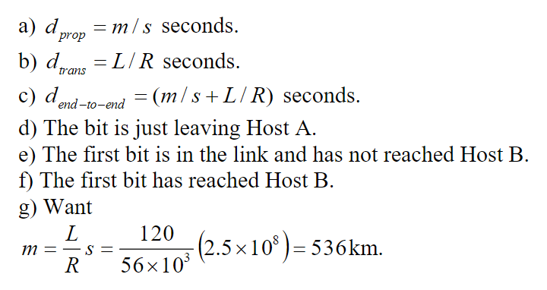

Slide 10
Consider a packet of length L which begins at end system A and travels over three links to a destination end system. These three links are connected by two packet switches. Let di, si, and Ri denote the length, propagation speed, and the transmission rate of link i, for i = 1, 2, 3. The packet switch delays each packet by dproc. Assuming no queuing delays, in terms of di, si, Ri,(i = 1,2,3), and L, what is the total end-to-end delay for the packet? Suppose now the packet is 1,500 bytes, the propagation speed on all three links is 2.5 ·10^8 m/s, the transmission rates of all three links are 2 Mbps, the packet switch processing delay is 3 msec, the length of the first link is 5,000 km, the length of the second link is 4,000 km, and the length of the last link is 1,000 km. For these values, what is the end-to-end delay?

Slide 11
=6+6+6+20+16+4+3+3 = 64 msec
=(1500*8/2Mbps)+ 1500*8/2Mbps+ 1500*8/2Mbps+5000km/2.5*10^8

Slide 12
In the above problem, suppose R1 = R2 = R3 = R and dproc = 0. Further suppose the packet switch does not store-and-forward packets but instead immediately transmits each bit it receives before waiting for the entire packet to arrive. What is the end-to-end delay?

Slide 13

=6+ 20 + 16 + 4 = 46msec

Slide 14
Review the car-caravan analogy in the previous section. Assume a propagation speed of 100 km/hour.
a. Suppose the caravan travels 150 km, beginning in front of one tollbooth, passing through a second tollbooth, and finishing just after a third tollbooth. What is the end-to-end delay?
b. Repeat (a), now assuming that there are eight cars in the caravan instead of ten.

Slide 15
Tollbooths are 75 km apart, and the cars propagate at 100km/hr. A tollbooth services a car at a rate of one car every 12 seconds.
a) There are ten cars. It takes 120 seconds, or 2 minutes, for the first tollbooth to service the 10 cars. Each of these cars has a propagation delay of 45 minutes (travel 75 km) before arriving at the second tollbooth. Thus, all the cars are lined up before the second tollbooth after 47 minutes. The whole process repeats itself for traveling between the second and third tollbooths. It also takes 2 minutes for the third tollbooth to service the 10 cars. Thus the total delay is 96 minutes.
b) Delay between tollbooths is 8*12 seconds plus 45 minutes, i.e., 46 minutes and 36 seconds. The total delay is twice this amount plus 8*12 seconds, i.e., 94 minutes and 48 seconds.

Slide 16
How long does it take a packet of length 1.45 kbytes to propagate down over a link of distance 500 m, propagation speed 2.5E8 m/s, and transmission rate 10 Mbps?

Slide 17
How long does it take a packet of length 1.45 kbytes to propagate down over a link of distance 500 m, propagation speed 2.5E8 m/s, and transmission rate 10 Mbps?
Packet length: | 1.45 kbytes
Link distance: | 500 m
Propagation speed: | 250,000,000 mps
Transmission rate: | 10 Mbps
Propagation time: | ____________
Propagation delay = distance / propagation speed = 2 Microsec. Transmission delay = (packet size / transmission rate) = 1.16 msec. Total delay = (transmission delay + propagation delay) = 1.162 msec.

Slide 18
Suppose Host A want to send a large file to Host B. The path from Host A to Host B has three links, of rates R1 = 1 Gbps, R2 = 50 Mbps, and R3 = 10 Gbps. (A.) Assuming no other traffic in the network, what is the throughput for the file transfer? (B.) Suppose the file is 20 Mbytes. Dividing the file size by the throughput, roughly how long will it take to transfer the file to Host B?

Slide 19
Suppose Host A want to send a large file to Host B. The path from Host A to Host B has three links, of rates R1 = 1 Gbps, R2 = 50 Mbps, and R3 = 10 Gbps. (A.) Assuming no other traffic in the network, what is the throughput for the file transfer? (B.) Suppose the file is 20 Mbytes. Dividing the file size by the throughput, roughly how long will it take to transfer the file to Host B?
Link R1: | 1 Gbps
Link R2: | 50 Mbps
Link R3: | 10 Gbps
File Size: | 20 Mbytes
(A) Throughput: | ____________
(B) Transfer time: | ____________
(A)Throughput = min(R1, R2, R3) = 50 Mbps (B)Transfer time = FileSize / Throughput = 3.2 sec

